Slide 1
Evolution of ESG Frameworks & Standards
May 11, 2023
Notes:
Hello, I am Lauren Uyeno, Director of the ESG Professionals Group. Thanks for joining us today.

Slide 2
Meet the ESG Pro Group
The ESG Professional Group is a community of professionals who are actively involved in reporting on environmental, social, or governance impact. The purpose of the community is to foster networking between members, provide industry knowledge, and discuss practical applications of best practices.
Membership is free and limited to those who are in-house sustainability reporters.
Members interact on an online community and have the opportunity to:
Meet others in ESG reporting and sustainability
Ask questions
Share advice
Attend meetings, special events, and webinars
Access a job board
Browse resources
esgprofessionals.org
Notes:
The ESG Professionals Group community was established in July 2022. Our mission is to connect with peers, share knowledge and answer questions.
Membership is free and unlocks the ability to connect you with practitioners in this space and provides opportunities for knowledge sharing, and thought leadership.
As a member, you will additionally be invited to more events like this, gain access to exclusive content, and be eligible to join the SEC and SOX & IC Professionals Groups.
If this is your first time with us, we invite you to check our online community and become a member.
Thank you to national sponsor, Workiva who underwrites costs for today’s event.

Slide 3
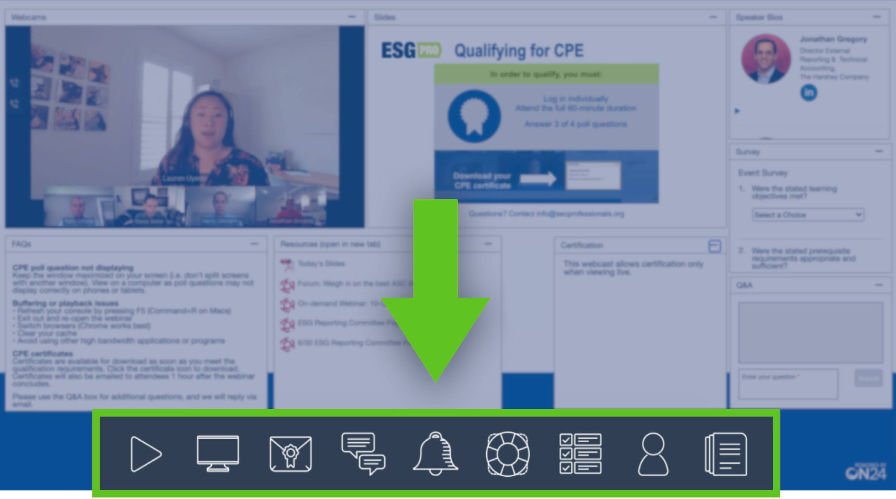
Notes:
At the bottom of your screen are multiple engagement tools. These tools allow you to customize your browser window.
Today’s slides and URLs to the ESG Pro Group community are available in the Resources section.
This event is being recorded and will be available to those who are members of the ESG Professionals Group community.
Once again, make sure you are registered. Link to the community is in the resources section.

Slide 4
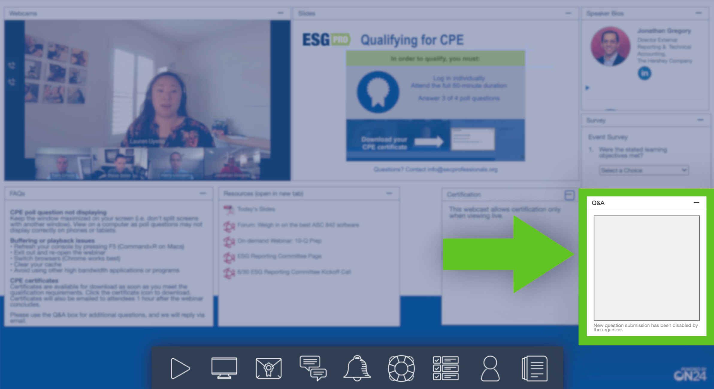
Notes:
Today’s panel is intended to be conversational. We welcome audience participation and questions! If you have questions, submit them using the Q&A chat box.
If you run into tech issues, refer to the FAQs section within your browser window. If your question is not answered in the FAQ section, submit it to the Q&A box.
If you have issues finding that Q&A box, refresh your browser window.

Slide 5
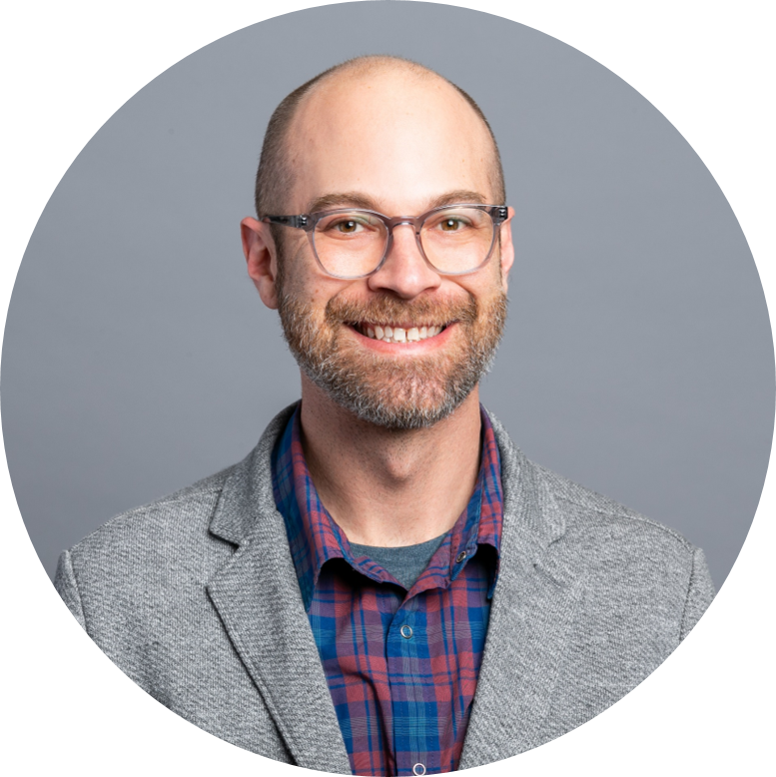
WELCOME!
Mark Mellen
Executive Advisor
ESG Professionals Group
Notes:
It’s my pleasure to introduce you to Mark Mellen. Mark is stepping in as the ESG Professionals Group’s Executive Advisor and he will be our moderator for today. Mark brings over 15 years of experience advising organizations in managing risk, especially focused on sustainability and ESG matters. He previously held a senior manager role with Deloitte’s Sustainability practice. Some of you have perhaps seen him more recently posting and answering questions on the community.
We are extremely happy to have him join our team. Welcome, Mark!

Slide 6
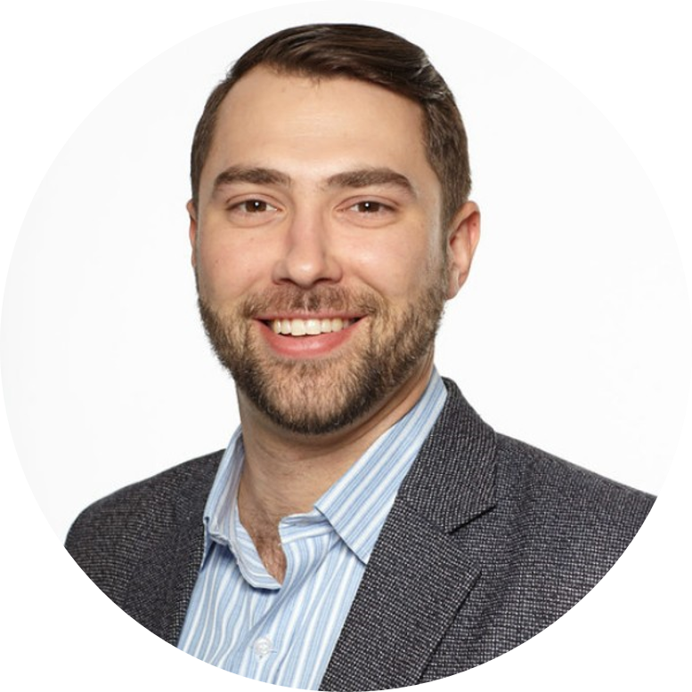
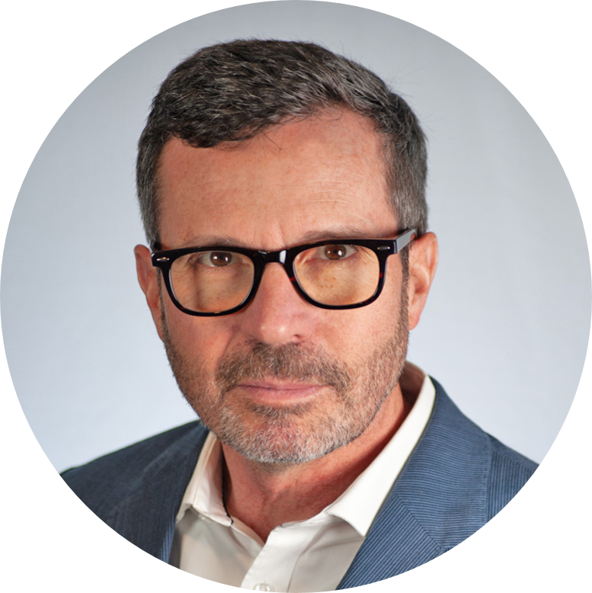
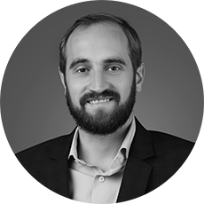
PANELISTS
Matthew Rusk
Head of GRI North America
GRI
Neil Stewart
Director of Corporate Outreach
IFRS Foundation
Simon Fischweicher
Head of Corporations and Supply Chains
CDP North America
Notes:
Now, it is my pleasure to introduce…

Slide 7
Q&A

Slide 8
UP NEXT
Become a member of ESG Pro Group
Post or reply to a question
Check out our first benchmark report
Save the date for the Q3 Meeting - 9/21
Notes:
If you enjoyed today’s webinar and would like to stay in the loop, don’t forget to join the ESG Professionals Group online community. Visit esgprofessionals.org to learn more and join (link in the resources section). Today’s event is being recorded and available to those who are members of the ESG Professionals Group community.
Membership is completely free and open to those who are sustainability practitioners. To our current members, I’d like to highlight a handful of discussions around CSRD, COSO Guidance, and Materiality Assessment. Join the conversation and provide your insights.
In other news, this year we published our first benchmark report. We asked members questions on the professional, technology stacks, and challenges. Take a look!
Please join us in September for the Q3 meeting. This meeting will be held in conjunction with Workiva’s Amplify conference. There will be options to attend in-person or virtual and admission to the ESG Pro Group Q3 meeting will be free. More details will be disclosed to members through the ESG Pro Group online community.

Slide 9
THANK YOU FOR JOINING TODAY’S MEETING!
Notes:
Thank you for tuning in to the Q2 ESG Professionals Group meeting. This concludes our session

